Slide 1


Cafeteria Online Ordering System In Universities
Naniya’s Cafeteria –online ordering website
Developed By:-
Muskaan Sharma (1610991542)
Muskan Garg(1610991545)
Nandish Guleria (1610991553)

Slide 2
Cafeteria Online Ordering System In Universities
Project Statement
In the universities, cafeteria is the main eating hub. Students just rush to the zone to have a byte and cool down their appetite. But they have to go through a long process and wait in a queue to ease their hunger pangs. During peak hours, the student crowd is so huge that it becomes very difficult to get an order placed and have that food in the limited break time.
So cafeteria online daily menu & recharge system can be proposed. It will enable the students to get their online recharge done and order placed easily with this system and they just have to collect the order thereby by showing their transactions. In this way, we can avoid longer, in fact never ending queues for order and recharge and hence can save ample time as food is fuel to the body.

Slide 3
Cafeteria Online Ordering System In Universities
Technology Used
Front end /Programming Tool
- HTML and CSS
- JavaScript
- jQuery
- Bootstrap

Slide 4
Cafeteria Online Ordering System In Universities
Flow Diagram :
Home Page
Login/ Sign Up Forms
About Us/Contact
Menu Catalog
Add to Cart
and Proceed to Payment

Slide 5
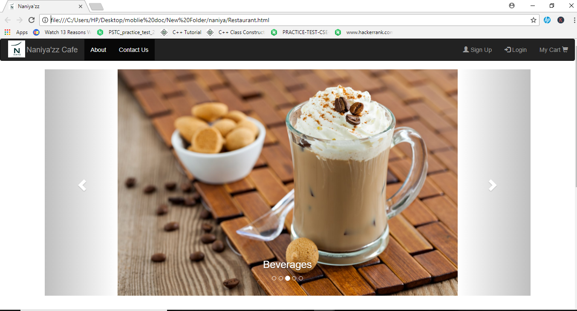
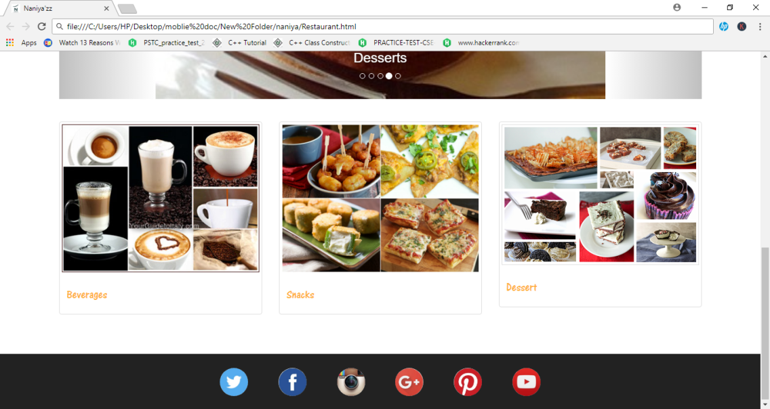
Cafeteria Online Ordering System In Universities
Snapshots:

Slide 6
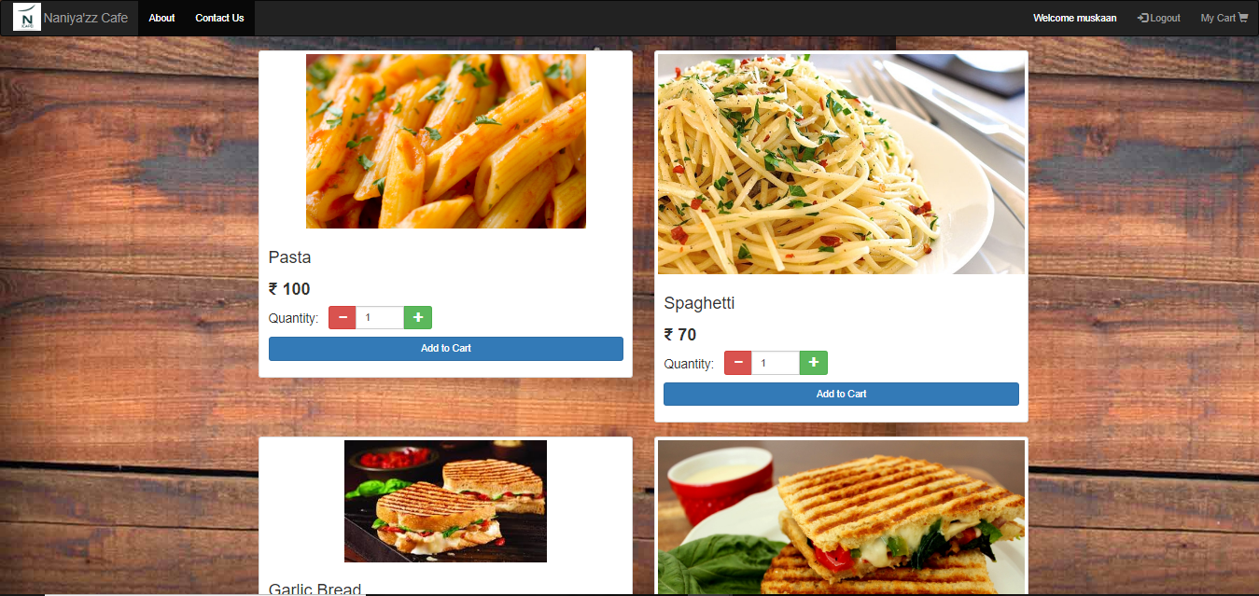
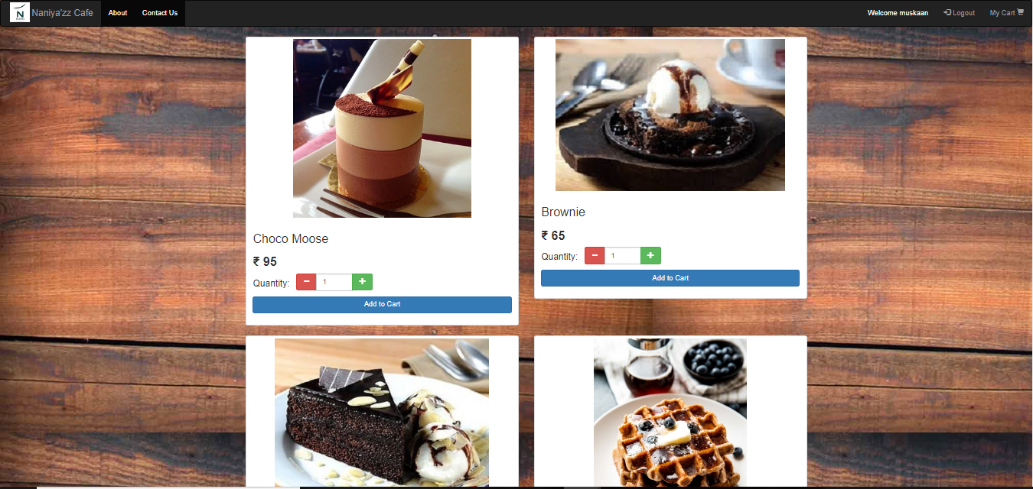
Cafeteria Online Ordering System In Universities

Slide 7
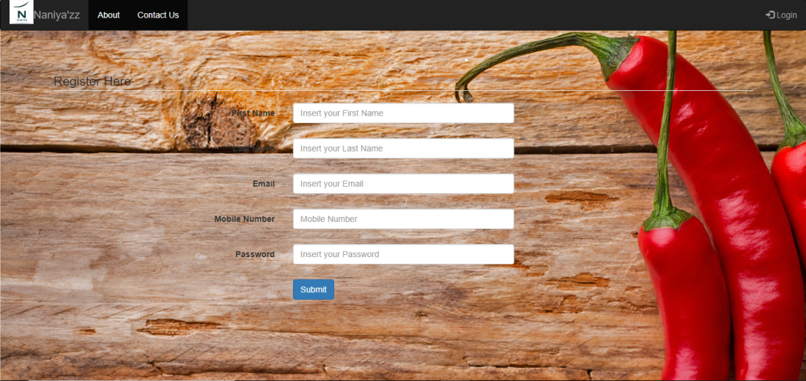
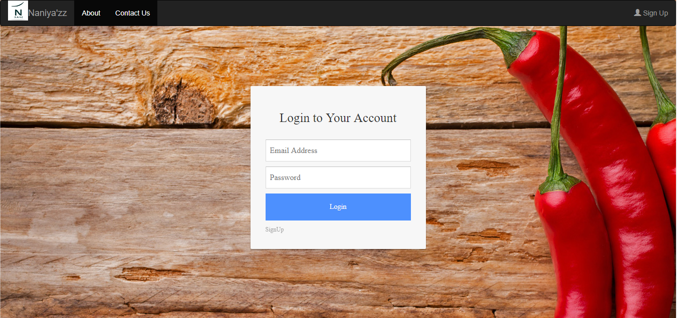
Cafeteria Online Ordering System In Universities

Slide 8
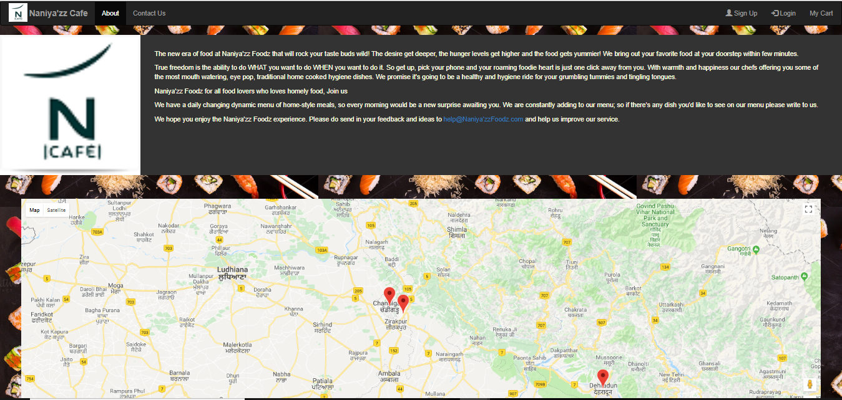
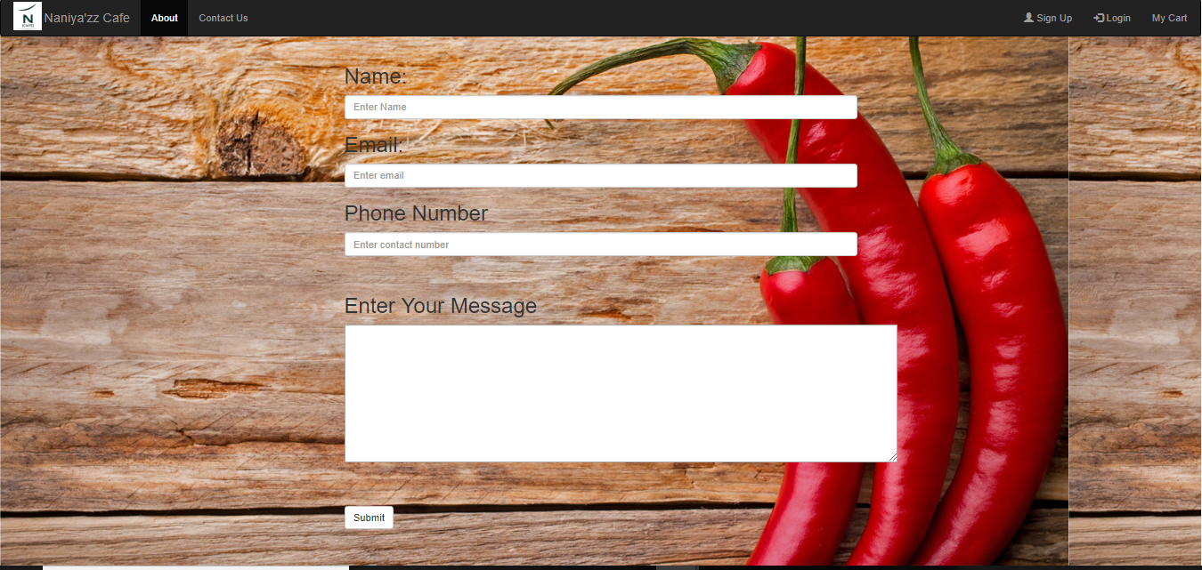
Cafeteria Online Ordering System In Universities

Slide 9
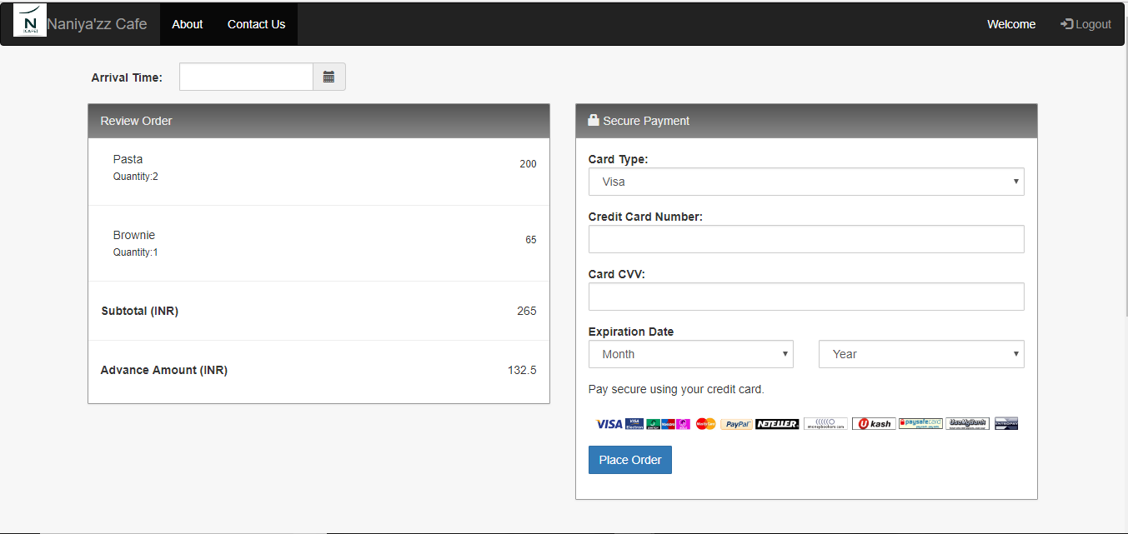
Cafeteria Online Ordering System In Universities

Slide 10
Cafeteria Online Ordering System In Universities
Future Scope:
This website will be very helpful to students as they won’t have to wait in long queues ,thus this site has a bright future.
Student can just make orders online and pay through card .
Then they just have to pick their order from the cafeteria .
That is what makes it all easy ,once it comes into practical implementation.
THANK YOU ☺

